Slide 1


HEP Weekly Report
George Bakas

Slide 2
Weekly Report
Top Tagger:
Subdominant Bkg Production ‘16,’17
Tried new WP’s to see if contamination will go below 1%. No result
Fit the Ratio Bkg Signal Region / Bkg Control Region because of the slope it shows for 2017 and 2018
Closure Tests with Scale Factors from Fit on the ratio
Fit on top Mass variable to extract bkg from data

Slide 3
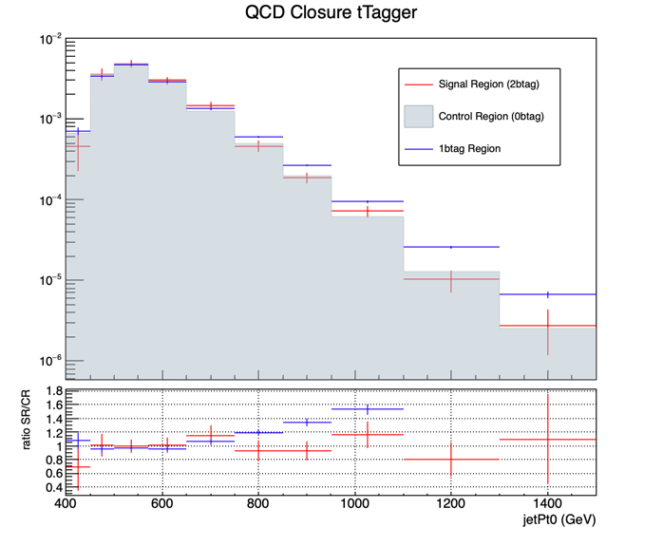
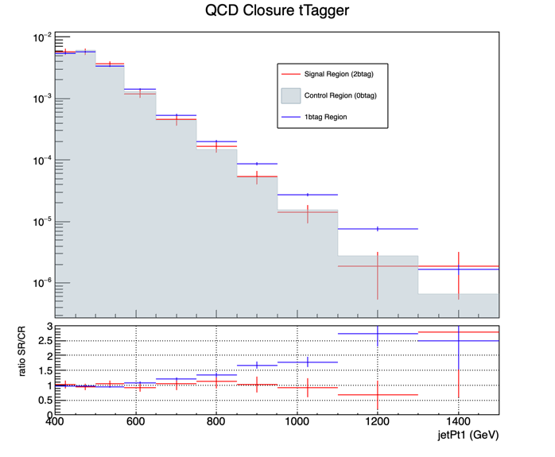
New Closure Tests 2017

Slide 4
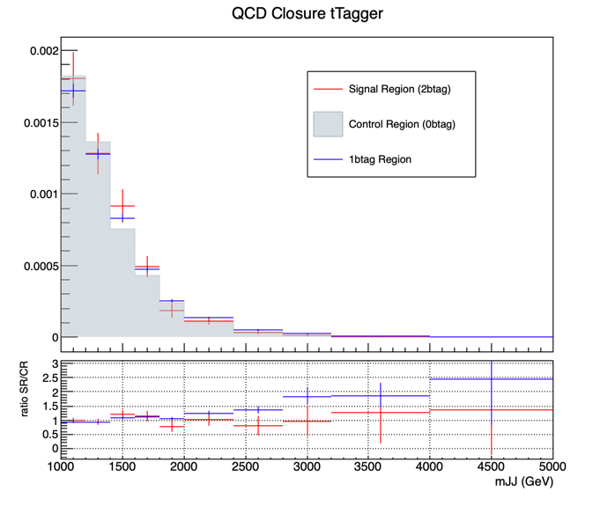
New Closure Tests 2017

Slide 5
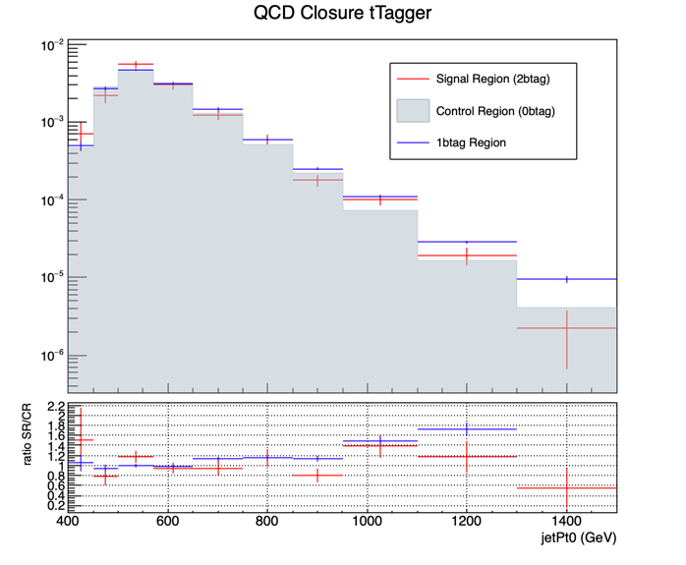
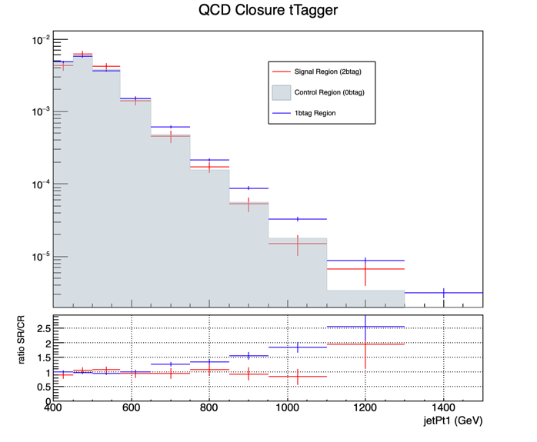
New Closure Tests 2018

Slide 6
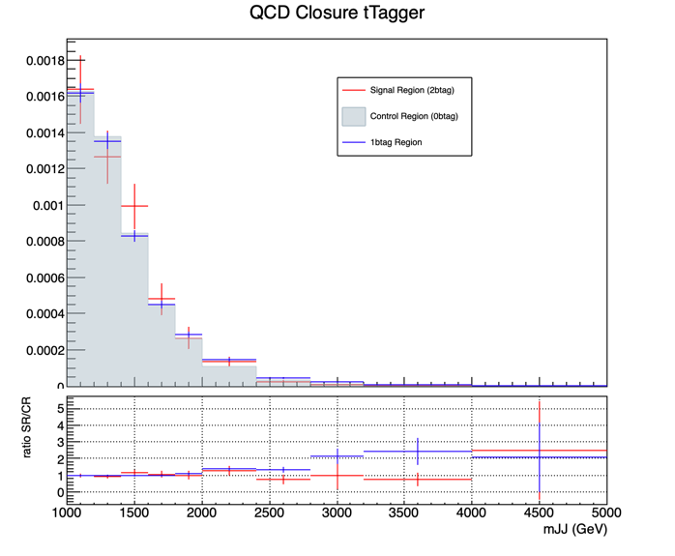
New Closure Tests 2018

